Slide 1
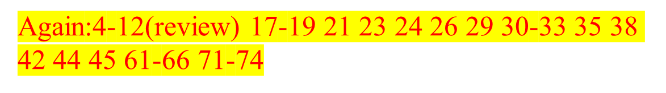
Operating Systems
Deadlock
Liu Fagui

Slide 2
Content of this lecture
Review
Resource
Deadlock
The Ostrich Algorithm
Deadlock detection & deadlock recovery
Deadlock avoidance
Deadlock prevention
Summary

Slide 3
Review ：Inter-Process Communication (IPC)
1.Communication
  Pass information to each other
2.Mutual exclusion & Synchronization
  Keep each other’s hair
  Proper sequencing
The last one also applies to threads

Slide 4
Review: IPC
Data races
Critical regions and mutual exclusions
Solutions:
  Peterson’s solution
  TSL
  Semaphores & Mutex
  Monitor
  Barrier
  Message Passing
Classic IPC Problems

Slide 5
Critical Region (Critical Section)
Critical Section：对共享内存进行访问的程序片段
Process {
while (true) {
ENTER CRITICAL SECTION
Access shared variables; // Critical Section; LEAVE CRITICAL SECTION
Do other work
}
}

Slide 6
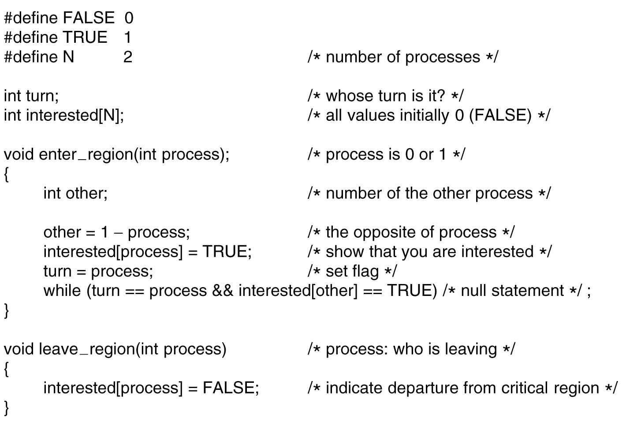
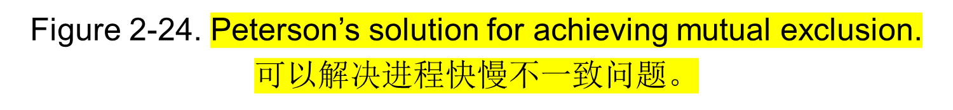
Peterson‘s Solution--简单的互斥算法

Slide 7
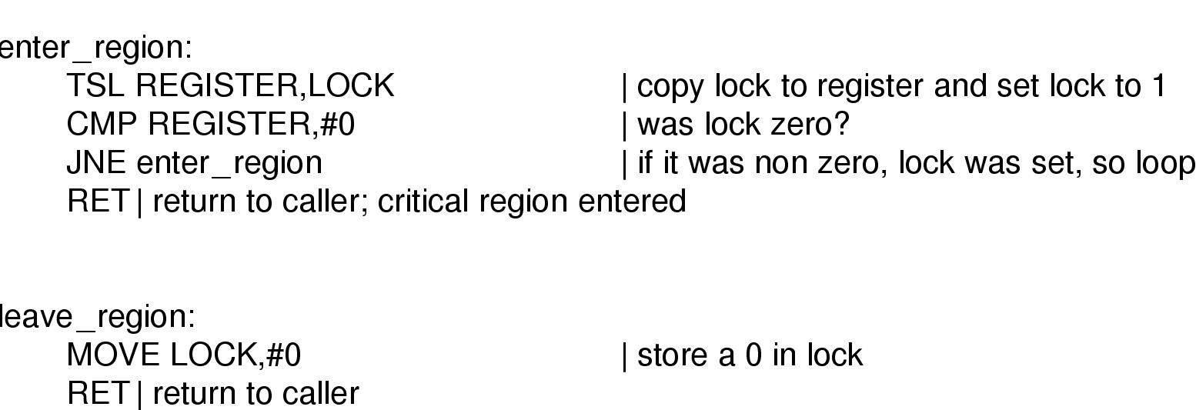
TSL instruction
Requires hardware support
Does test and set atomically 锁住存储总线.

Slide 8
Semaphores
A semaphore count represents count number of abstract resources.
New variable having 2 operations
  The Down (P) operation is used to acquire a resource and decrements count.
  The Up (V) operation is used to release a resource and increments count.
Any semaphore operation is indivisible (atomic: what else we have talked before is atomic?)
Semaphores solve the problem of the wakeup-bit

Slide 9
Implementations of Semaphore using Sleep & Wakeup
type Semaphore = record
value:integer;
L: list of processes;
Semaphore S;
Down(S):
S.value:= S.value - 1;
if S. value < 0 then
{ block;
add this process to the S.L;
};
Up(S):
S.value:= S.value + 1;
if S.value <= 0 then
{
remove process P from S.L;
wakeup(P);
}

Slide 10
First Reader-Writer Problem
A reader: read data
A writer: write data
Rule:
  Multiple readers can read the data simultaneously
  Only one writer can write the data at any time
  A reader and a writer cannot in critical section together.
Locking table: whether any two can be in the critical section simultaneously
Group discussion (2 minutes)
Does it work? Why?
What if ?
Problem with this solution
 | Reader | Writer
Reader | OK | No
Writer | NO | No

Slide 11

Semaphore mutex, wrt; // shared and initialized to 1;
int readcount; // shared and initialized to 0
// Writer // Reader
Down(mutex);
readcount:=readcount+1;
Down(wrt); if readcount == 1 then Down(wrt);
...... Up(mutex);
writing performed ....
..... reading performed
Down(mutex);
Up(wrt); readcount:=readcount-1;
if readcount == 0 then Up(wrt);
Up(mutex);

Slide 12
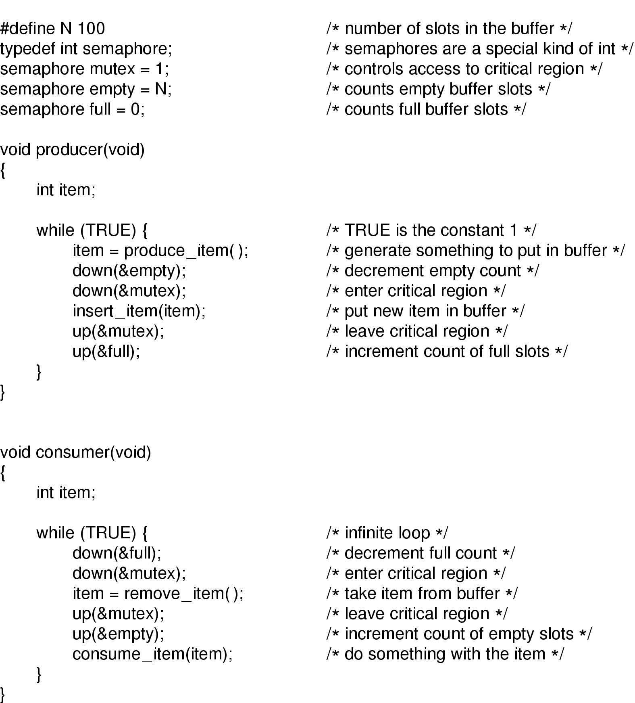
Producer-Consumer Problem using Semaphores

Slide 13
Resource (1)
A resource is a commodity needed by a process.
Resources can be either:
  serially reusable(连续使用): e.g., CPU, memory, disk space, I/O devices, files.
  acquire → use → release
  Consumable(消耗的): produced by a process, needed by a process; e.g., messages, buffers of information, interrupts.
  create → acquire → use
  Resource ceases(终了) to exist after it has been used, so it is not released.

Slide 14
Resource (2)
Resources can also be either:
  Preemptible（可抢占）: e.g., CPU, central memory or
  non-preemptible （非抢占） : e.g., tape drives.
And resources can be either:
  shared among several processes or
  dedicated(专用) exclusively to a single process.

Slide 15
Using Semaphore to Share Resource
Process P();
{ A.Down();
B.Down();
use both resource
B.Up();
A.Up(); }
Process Q();
{ A.Down();
B.Down();
use both resource
B.Up();
A.Up(); }
0
2
6
3
4
5
External Semaphore A(1), B(1);
2
External Semaphore A(0), B(1);
3
External Semaphore A(0), B(0);
4
External Semaphore A(0), B(1);
5
External Semaphore A(1), B(1);

Slide 16
But Deadlock can Happen!
1
Process P();
{ A.Down();
B.Down();
use both resources
B.Up();
A.Up(); }
Process Q();
{ B.Down();
A.Down();
use both resources
A.Up();
B.Up(); }
1
2
3
DEADLOCK
1
External Semaphore A(1), B(1);
2
External Semaphore A(0), B(1);
3
External Semaphore A(0), B(0);

Slide 17
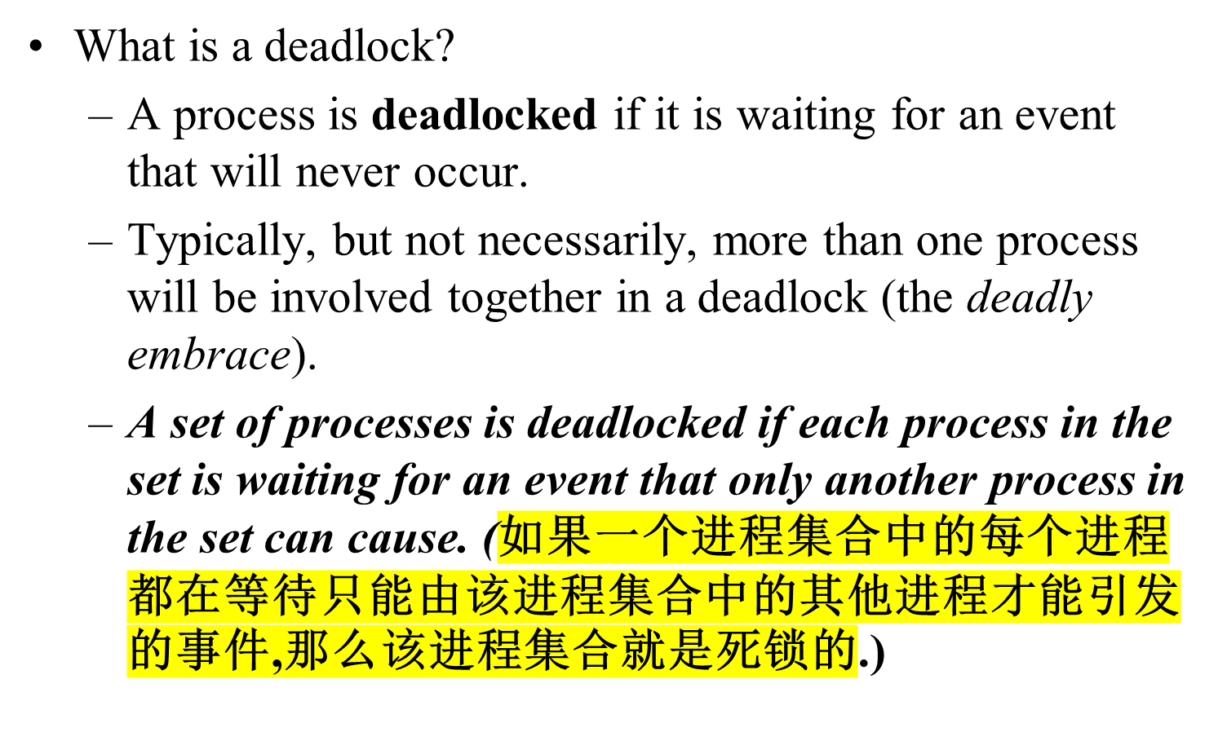
Deadlock Definition

Slide 18
Necessary and Sufficient Conditions for Deadlock
Mutual exclusion
  Processes claim exclusive control of the resources they require
Hold and wait condition
  Processes hold resources already allocated to them while waiting for additional resources
No preemption condition
  Resources cannot be removed from the processes holding them until used to completion
Circular wait condition
  A circular chain of processes exists in which each process holds one or more resources that are requested by the next process in the chain

Slide 19



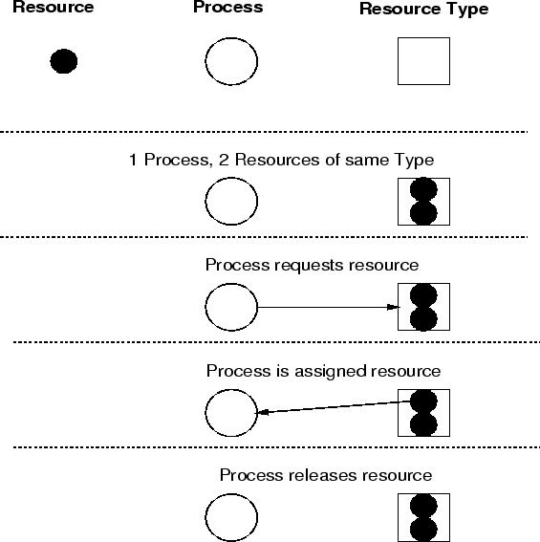


Resource Allocation Graph

Slide 20
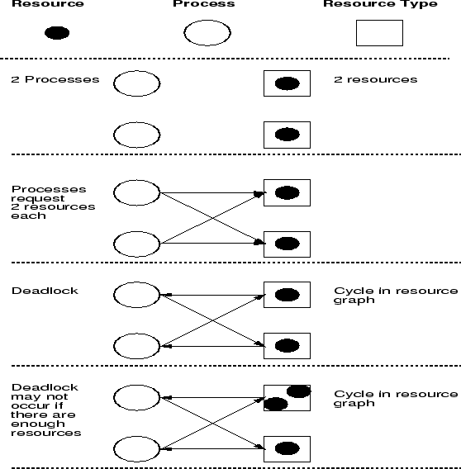

Deadlock Model

Slide 21
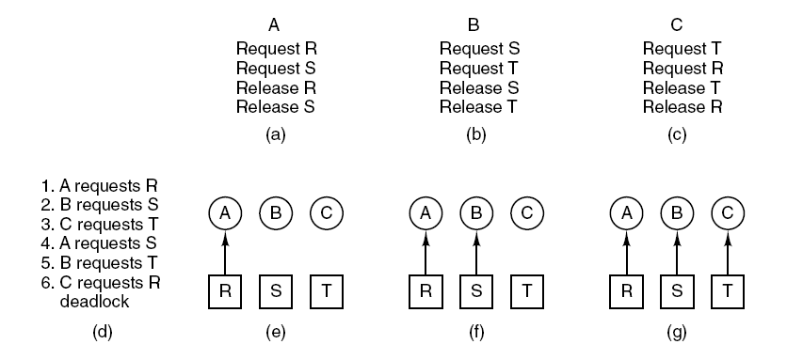
Deadlock Modeling (2)
Figure 6-4. An example of how deadlock occurs
and how it can be avoided.

Slide 22
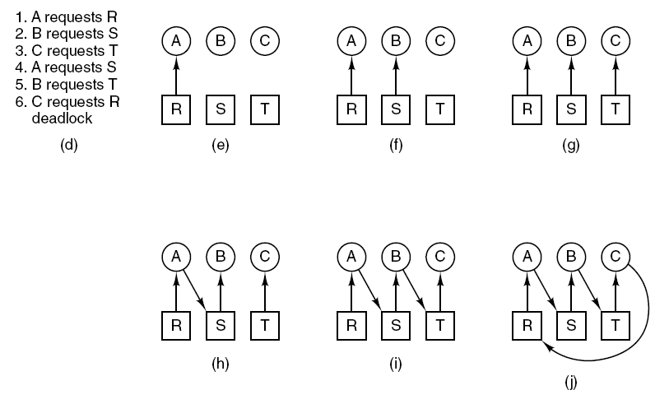

Deadlock Modeling (3)
Figure 6-4. An example of how deadlock occurs
and how it can be avoided.

Slide 23
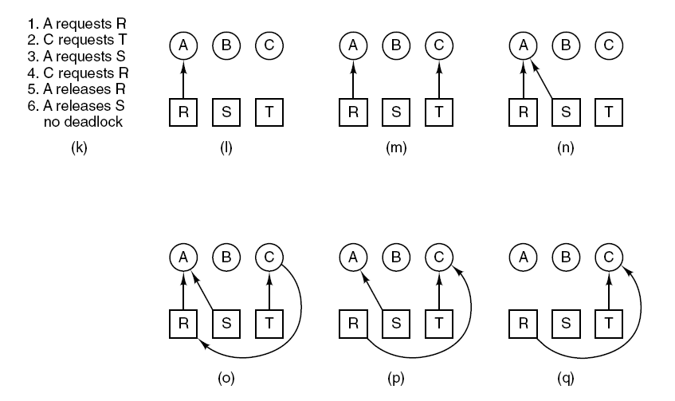
Deadlock Modeling (4)
Figure 6-4. An example of how deadlock occurs
and how it can be avoided.
Tanenbaum, Modern Operating Systems 3 e, (c) 2008 Prentice-Hall, Inc. All rights reserved. 0-13-6006639

Slide 24

Deadlock Issues(1)
Strategies for dealing with deadlocks:
Just ignore the problem.
Detection and recovery. Let deadlocks occur, detect them, take action.
Dynamic avoidance by careful resource allocation. (Avoidance)
Prevention, by structurally negating one of the four required conditions.

Slide 25
Deadlock Issues(2)
Detection
  in a system that allows the possibility of deadlock, determine if deadlock has occurred, and which processes and resources are involved.
Recovery
  after a deadlock has been detected, clear the problem, allowing the deadlocked processes to complete and the resources to be reused. Usually involves destroying the affected processes and starting them over.
Avoidance
  impose less stringent conditions than for prevention, allowing the possibility of deadlock, but sidestepping it as it approaches.
Prevention
  design a system in such a way that deadlocks cannot occur, at least with respect to serially reusable resources.

Slide 26
The Ostrich Algorithm (驼鸟算法)
Don’t do anything, simply restart the system (stick your head into the sand, pretend there is no problem at all).
Rational: make the common path faster and more reliable
  Deadlock prevention, avoidance or detection/recovery algorithms are expensive
  if deadlock occurs only rarely, it is not worth the overhead to implement any of these algorithms.

Slide 27
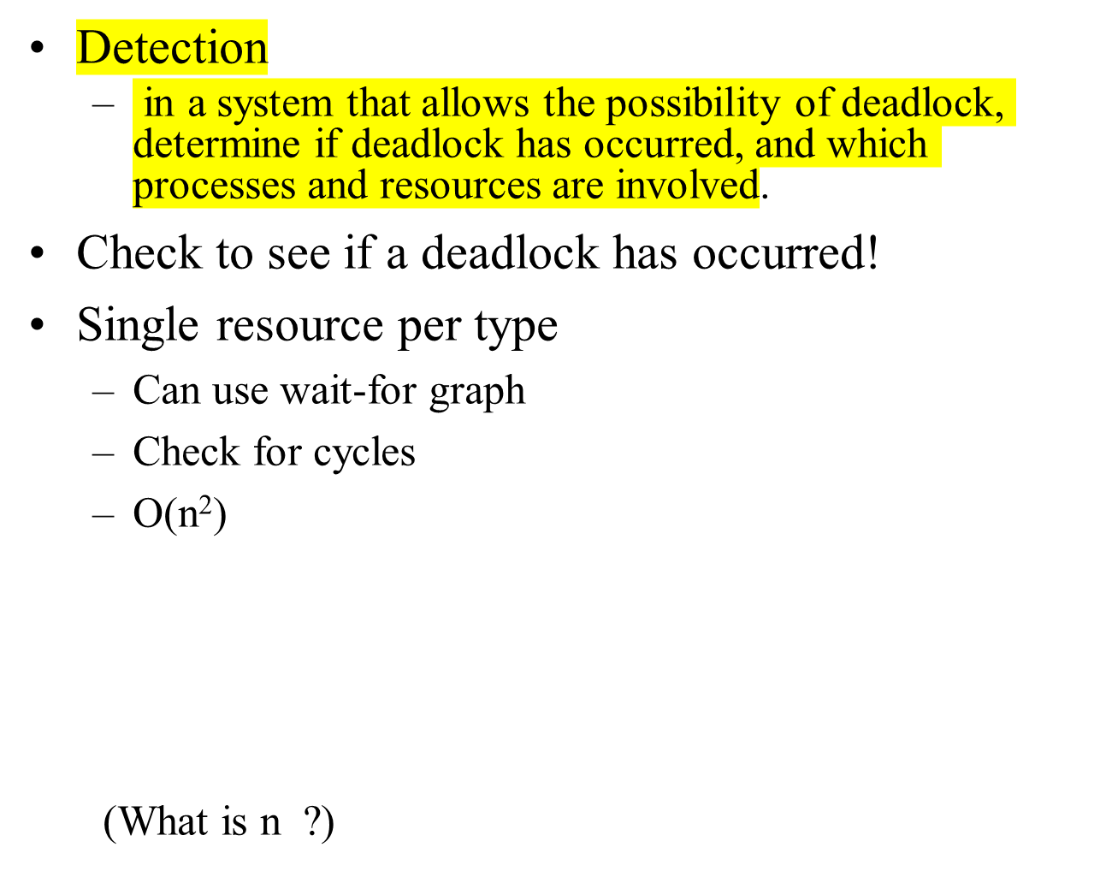
Deadlock Detection

Slide 28
Wait for Graphs
Resource Allocation Graph
Corresponding Wait For Graph

Slide 29
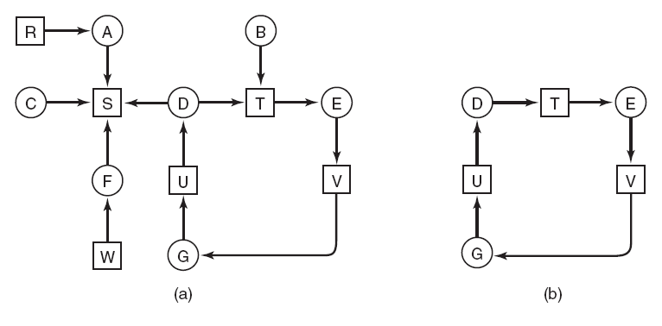
Deadlock Detection with
One Resource of Each Type (1)
Figure 6-5. (a) A resource graph. (b) A cycle extracted from (a).
(a) A resource graph.
(b) A cycle extracted from (a)（从a中抽取的环）.

Slide 30
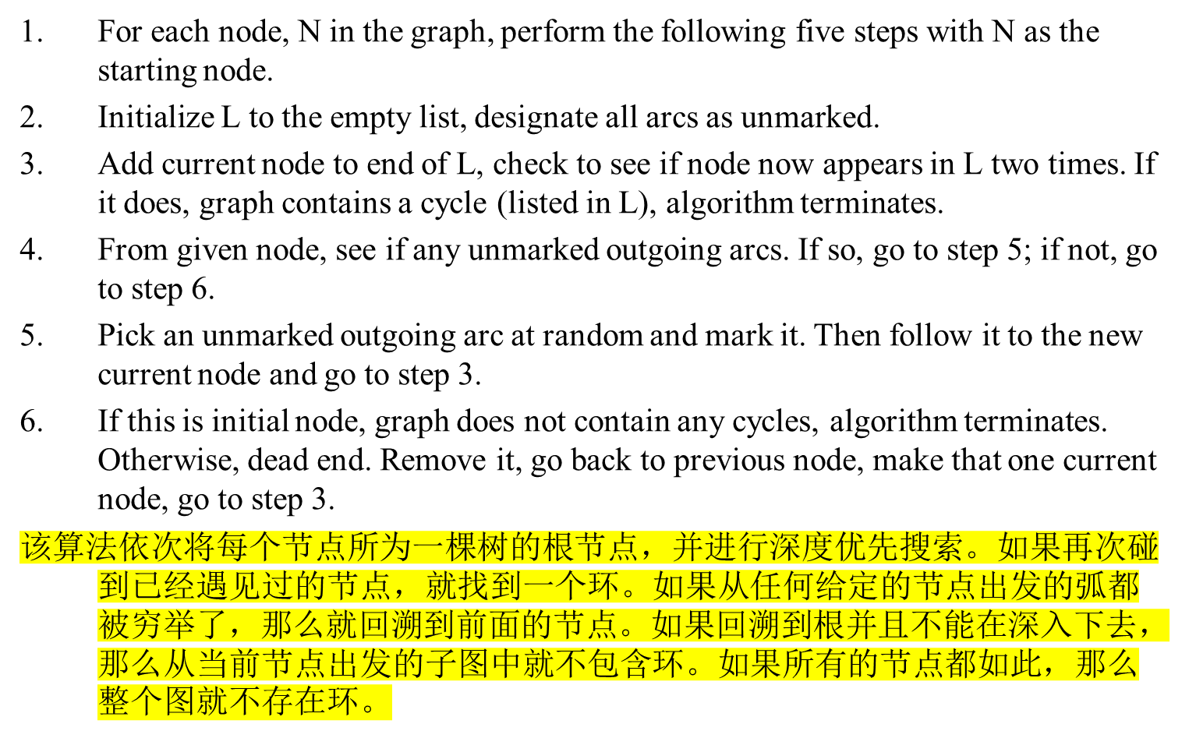
Deadlock Detection with One Resource of Each Type ----Algorithm for detecting deadlock（L代表一些节点的集合）

Slide 31
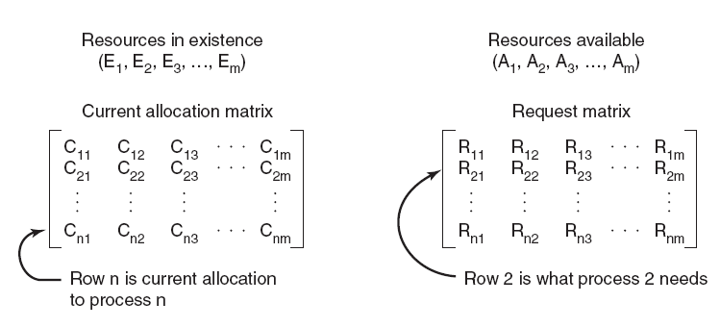
Deadlock Detection with Multiple Resources of Each Type (1)
Figure 6-6. The four data structures needed
by the deadlock detection algorithm.
Figure 6-6. The four data structures needed
by the deadlock detection algorithm.

Slide 32
Deadlock Detection with Multiple Resources of Each Type (2)
Deadlock detection algorithm:
Look for an unmarked process, P_{i} , for which the i-th row of R(Request Matrix) is less than or equal to A(available allocation matrix).
If such a process is found, add the i-th row of C (Current allocation matrix) to A, mark the process, and go back to step 1.
If no such process exists, the algorithm terminates.
算法结束时,所有没有标记过的进程(如果存在的话)都是死锁进程.

Slide 33
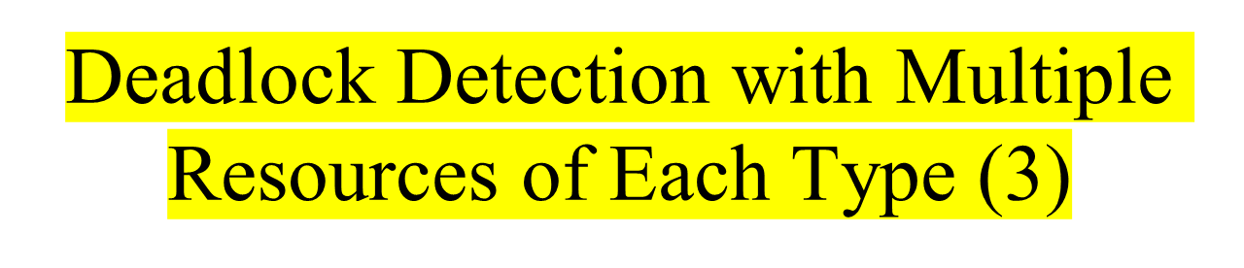
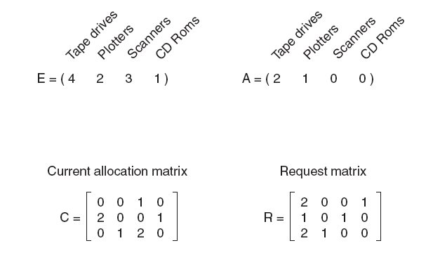

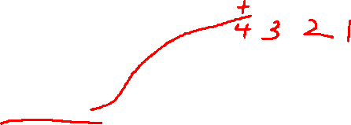
An example for the deadlock detection algorithm. (P3,P2,P1).

Slide 34
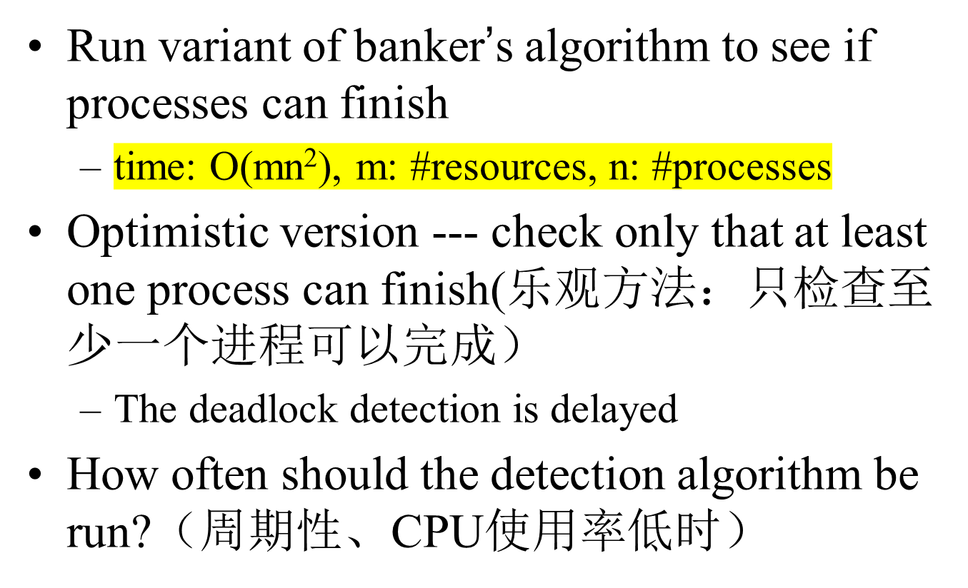
Multiple resources per type

Slide 35
Recovery from Deadlock
Recovery through preemption
Recovery through rollback
Recovery through killing processes

Slide 36
Recovery From Deadlock
OPTIONS:
  Kill deadlocked processes and release resources
  Kill one deadlocked process at a time and release its resources
  Rollback all or one of the processes to a checkpoint that occurred before they requested any resources
Note: with rollback, difficult to prevent indefinite postponement(无限的延迟）

Slide 37
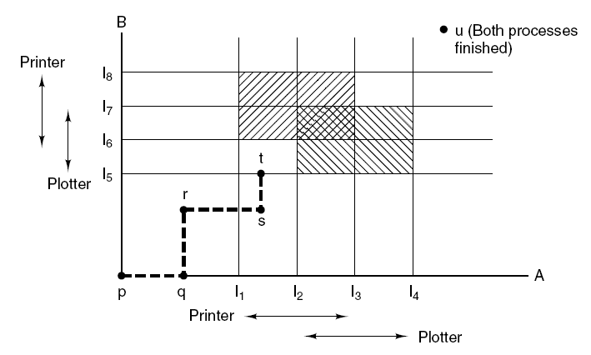


Deadlock Avoidance
B进程
Figure 6-8. Two process resource trajectories.
A进程
Figure 6-8. Two process resource trajectories.

Slide 38
Deadlock Avoidance(2)
The system needs to know the resource ahead of time
Banker Algorithm (Dijkstra, 1965)
  Each customer tells banker the maximum number of resources it needs
  Customer borrows resources from banker
  Customer returns resources to banker
  Customer eventually pays back loan
  Banker only lends resources if the system will be in a safe state after the loan
Safe state - there is a lending sequence such that all customers can take out a loan
Unsafe state - there is a possibility of deadlock

Slide 39
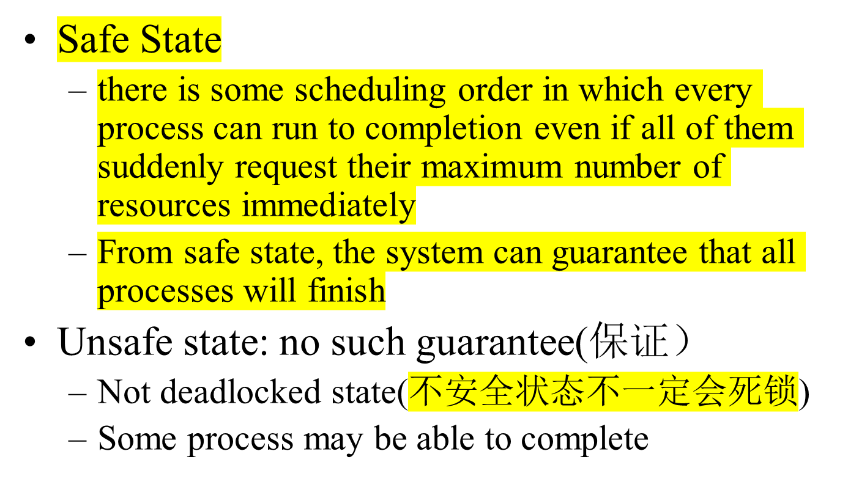
Safe State and Unsafe State

Slide 40
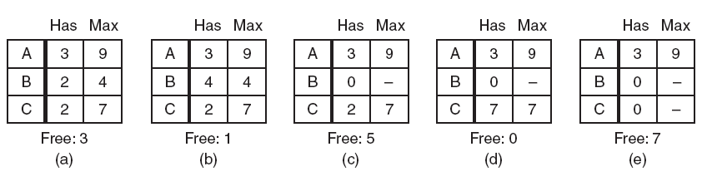
Safe and Unsafe States (1)
Demonstration that the state in (a) is safe. (B,C,A)

Slide 41
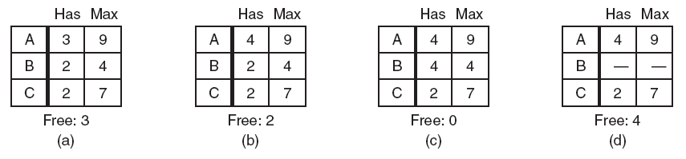
Safe and Unsafe States (2)
Demonstration that the state in (b) is not safe.

Slide 42
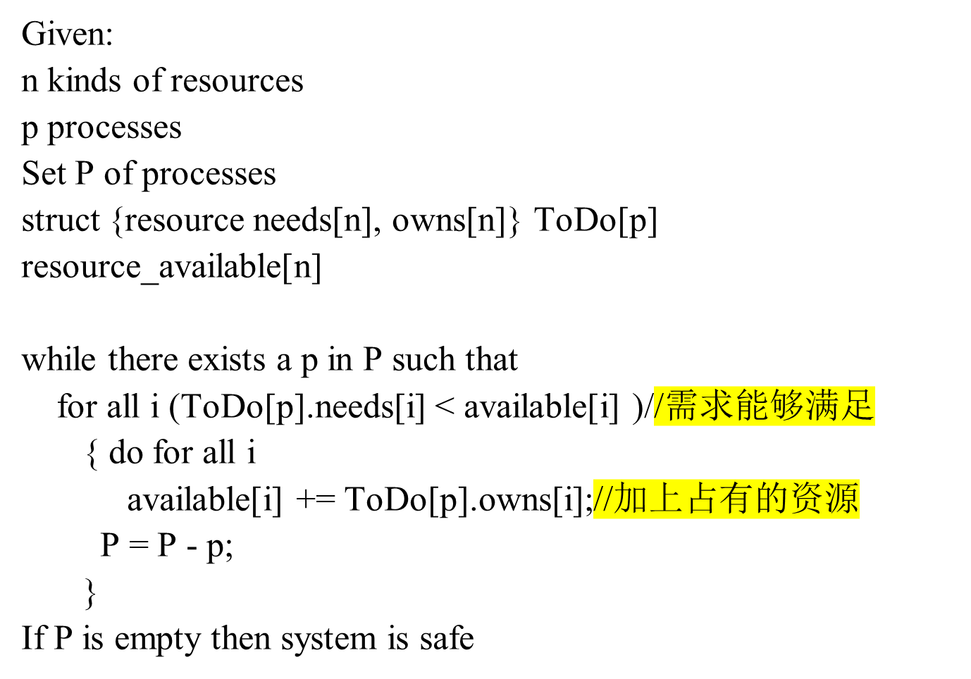
How to Compute Safety

Slide 43
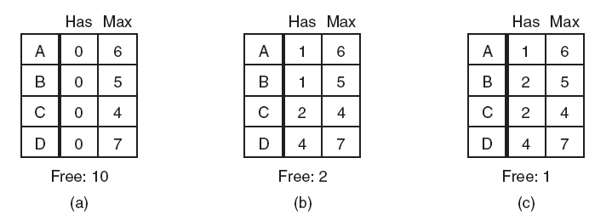
The Banker’s Algorithm for a Single Resource
Figure 6-11. Three resource allocation states:
(a) Safe. (b) Safe. (c) Unsafe.
Figure 6-11. Three resource allocation states:
(a) Safe. (b) Safe. (c) Unsafe.

Slide 44
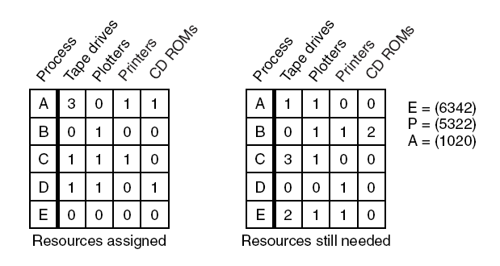
The Banker’s Algorithm for Multiple Resources (1)
Figure 6-12. The banker’s algorithm with multiple resources.
The banker’s algorithm with multiple resources.
E:原有资源.P:已分配资源.A:可用资源

Slide 45
The Banker’s Algorithm for Multiple Resources (2)
Algorithm for checking to see if a state is safe:
Look for row, R, whose unmet resource needs all
≤ A. If no such row exists, system will eventually deadlock since no process can run to completion
Assume process of row chosen requests all resources it needs and finishes. Mark process as terminated, add all its resources to the A vector.
Repeat steps 1 and 2 until either all processes marked terminated (initial state was safe) or no process left whose resource needs can be met (there is a deadlock).

Slide 46
Is Allocation (1 0 2) to P1 Safe?
Process
Alloc
Max
Need
Available
A
B
C
A
B
C
A
B
C
A
B
C
P0
0
1
0
7
5
3
7
4
3
10
5
5
P1
2
0
0
3
2
2
1
2
2
3
3
2
P2
3
0
0
9
0
2
6
0
2
P3
2
1
1
2
2
2
0
1
1
P4
0
0
2
4
3
3
4
3
1
If P1 requests max resources, can complete

Slide 47
And Run Safety Test: Group Discussion
Process
Alloc
Max
Need
Available
A
B
C
A
B
C
A
B
C
A
B
C
P0
0
1
0
7
5
3
7
4
3
10
5
5
P1
3
0
2
3
2
2
0
2
0
2
3
0
P2
3
0
0
9
0
2
6
0
2
P3
2
1
1
2
2
2
0
1
1
P4
0
0
2
4
3
3
4
3
1
If P1 requests max resources, can complete

Slide 48
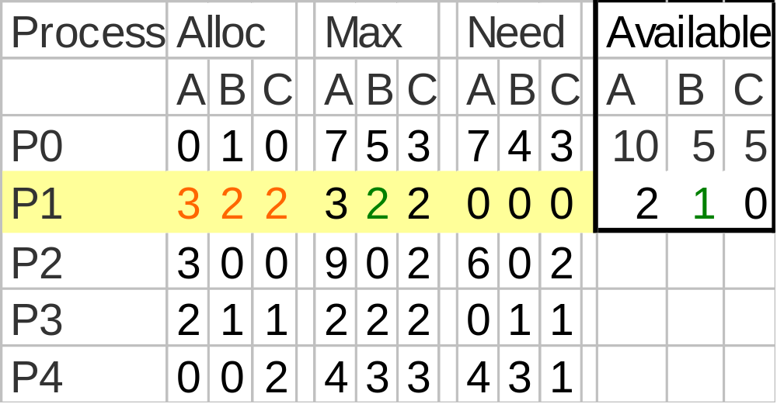
Allocate to P1, Then

Slide 49
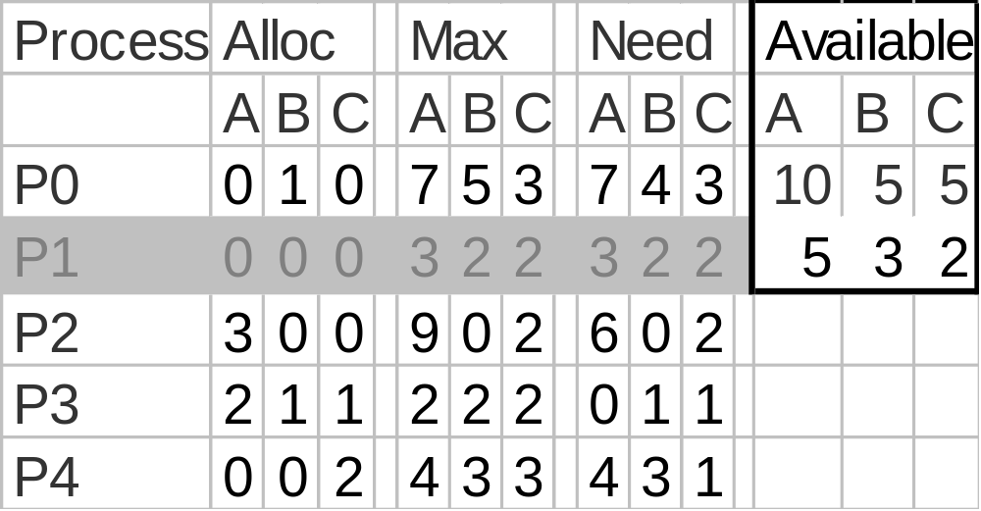
Release - P1 Finishes
Now P3 can acquire max resources and release

Slide 50
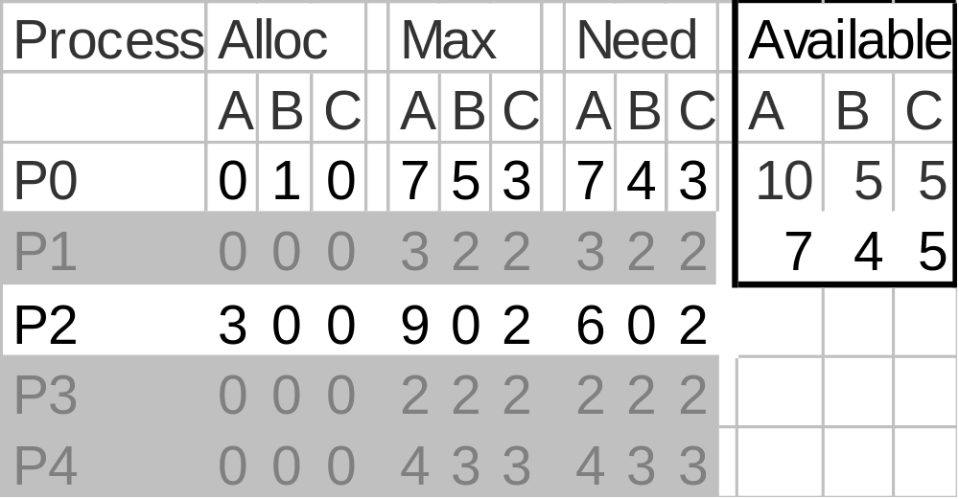
Release - P4 Finishes
Now P2 can acquire max resources and release

Slide 51
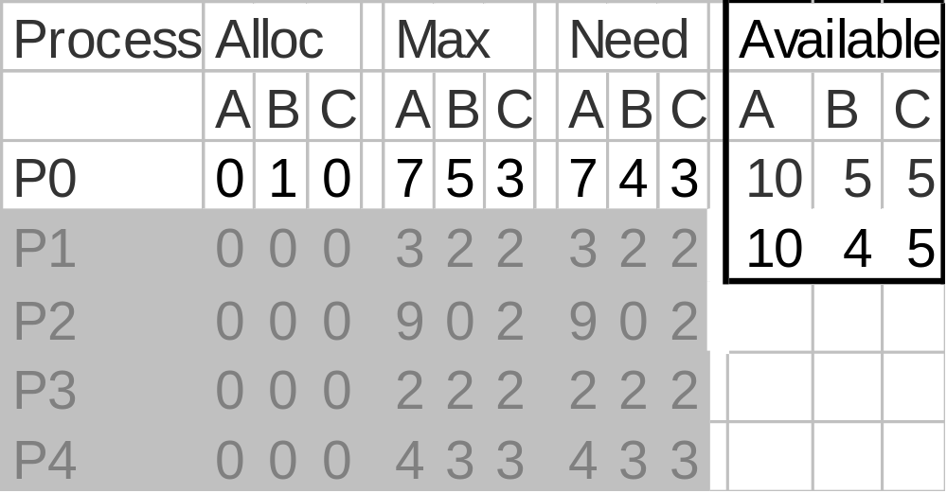
Release - P2 Finishes
Now P0 can acquire max resources and release

Slide 52
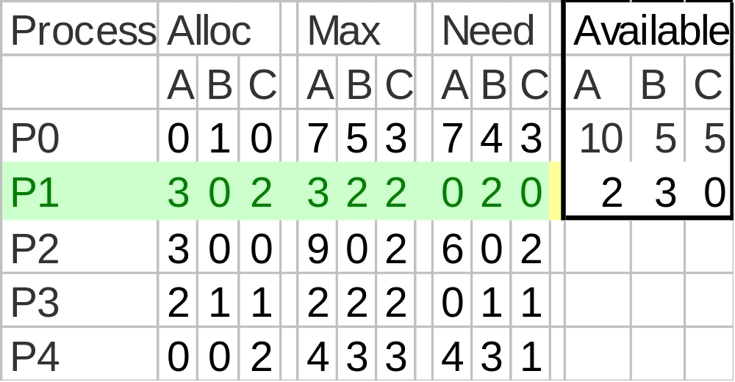
So P1 Allocation (1 0 2) Is Safe

Slide 53
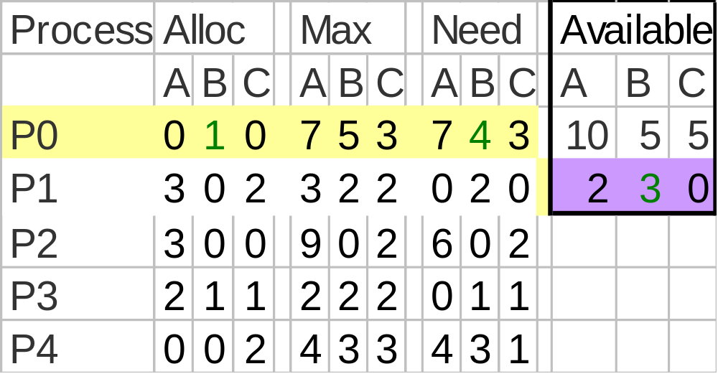
Is allocation (0 2 0) to P0 Safe?
Try to Allocate 2 B to P0

Slide 54
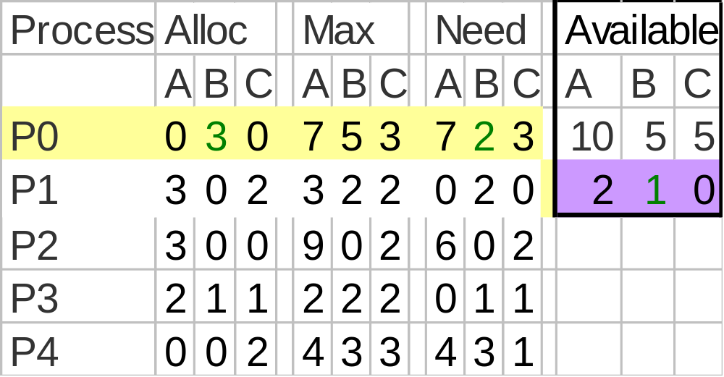
Run Safety Test
No Processes may get max resources and release

Slide 55

So Unsafe State- Do Not Enter

Slide 56
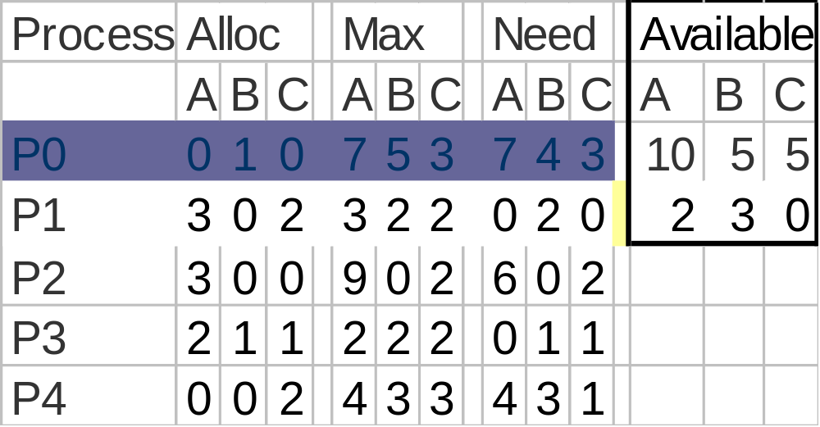
P0 Suspended Pending Request
When enough resources become available, P0 can awake

Slide 57
Results
P0’s request for 2 Bs cannot be granted because that would prevent any other process from completing if they need their maximum claim

Slide 58
Just Because Its Unsafe---
P0 could have been allocated 2 Bs and a deadlock might not have occurred if:
  P2 say didn’t use its maximum resources but finished using the resources it had

Slide 59
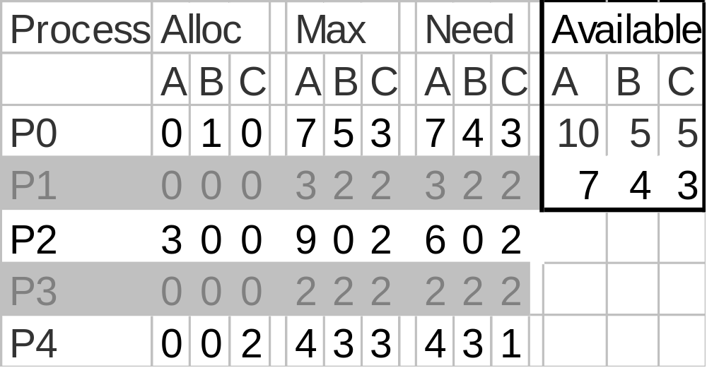
Release - P3 Finishes
Now P4 can acquire max resources and release

Slide 60
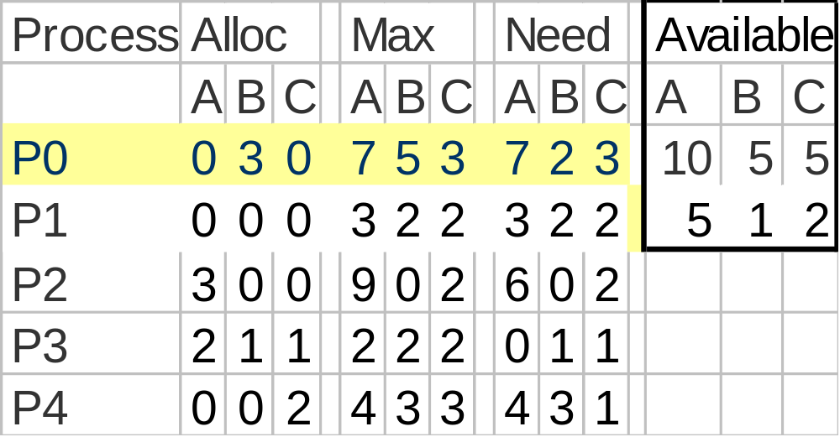
If P1 Doesn’t Need Max---
Then P0 would have finished…

Slide 61
Tradeoff
The banker’s algorithm is conservative (保守的)--- it reduces parallelism for safety sake
What is the trade-off?

Slide 62
Deadlock Prevention
Attacking the mutual exclusion condition
Attacking the hold and wait condition
Attacking the no preemption condition
Attacking the circular wait condition

Slide 63
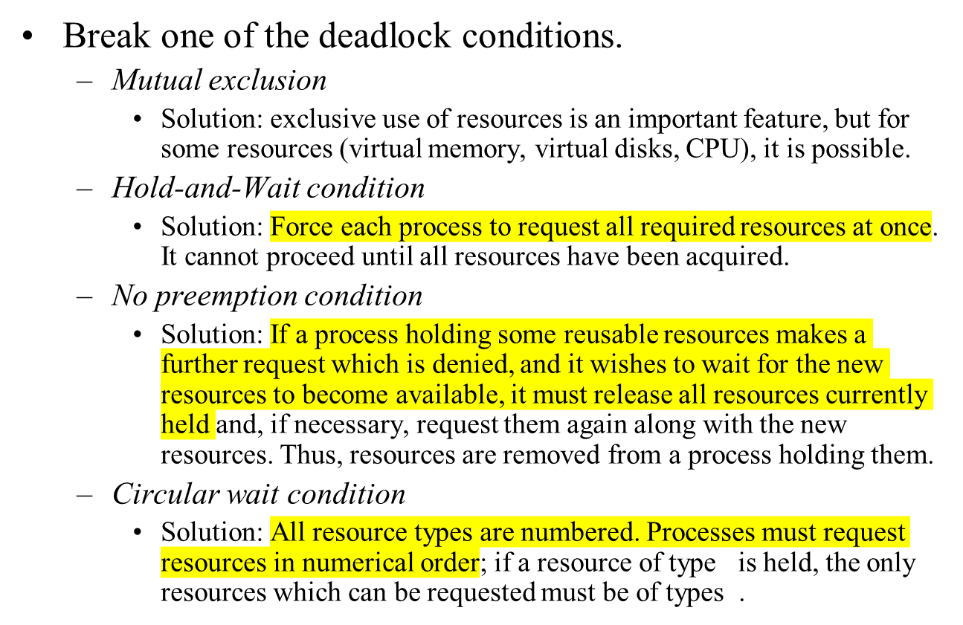
Deadlock Prevention: Havender's Algorithms

Slide 64
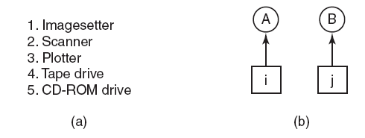
Attacking the
Circular Wait Condition
Figure 6-13. (a) Numerically ordered resources.
(b) A resource graph.

Slide 65
Break Circular Wait Condition
Request one resource at a time. Release the current resource when request the next one
Global ordering of resources
  Requests have to made in increasing order
  Req(resource1), req(resource2)..
  Why no circular wait?

Slide 66
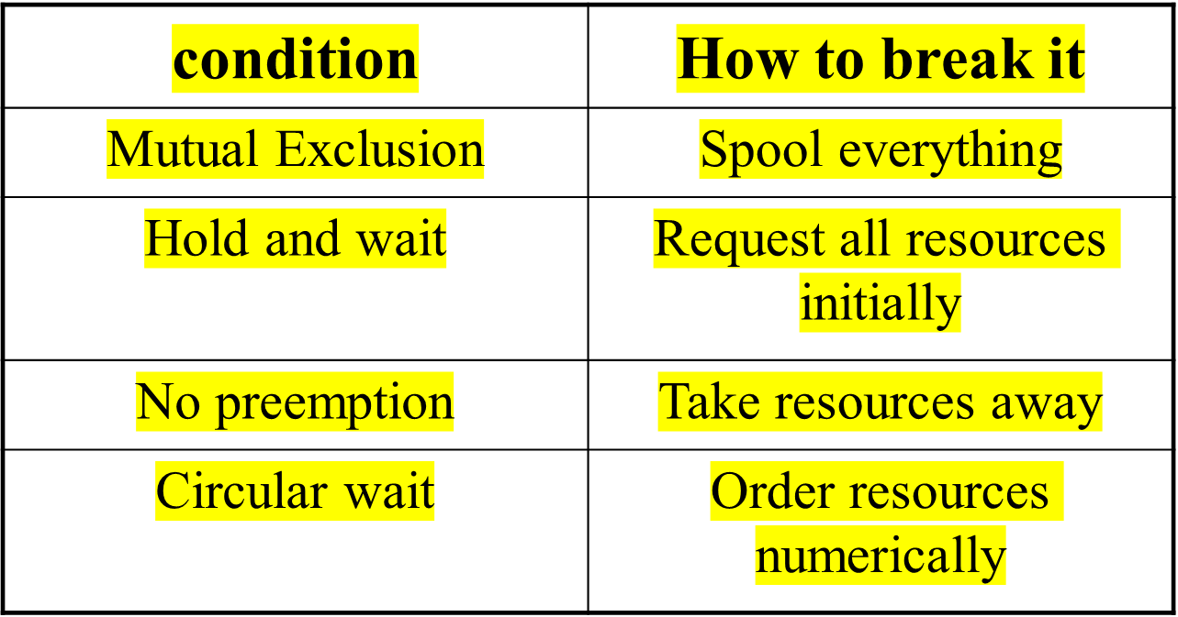
Summary: Deadlock Prevention

Slide 67

Dining Philosophers:Demo
Philosophers eat/think
Eating needs 2 forks
Pick one fork at a time Possible deadlock?
How to prevent deadlock?

Slide 68
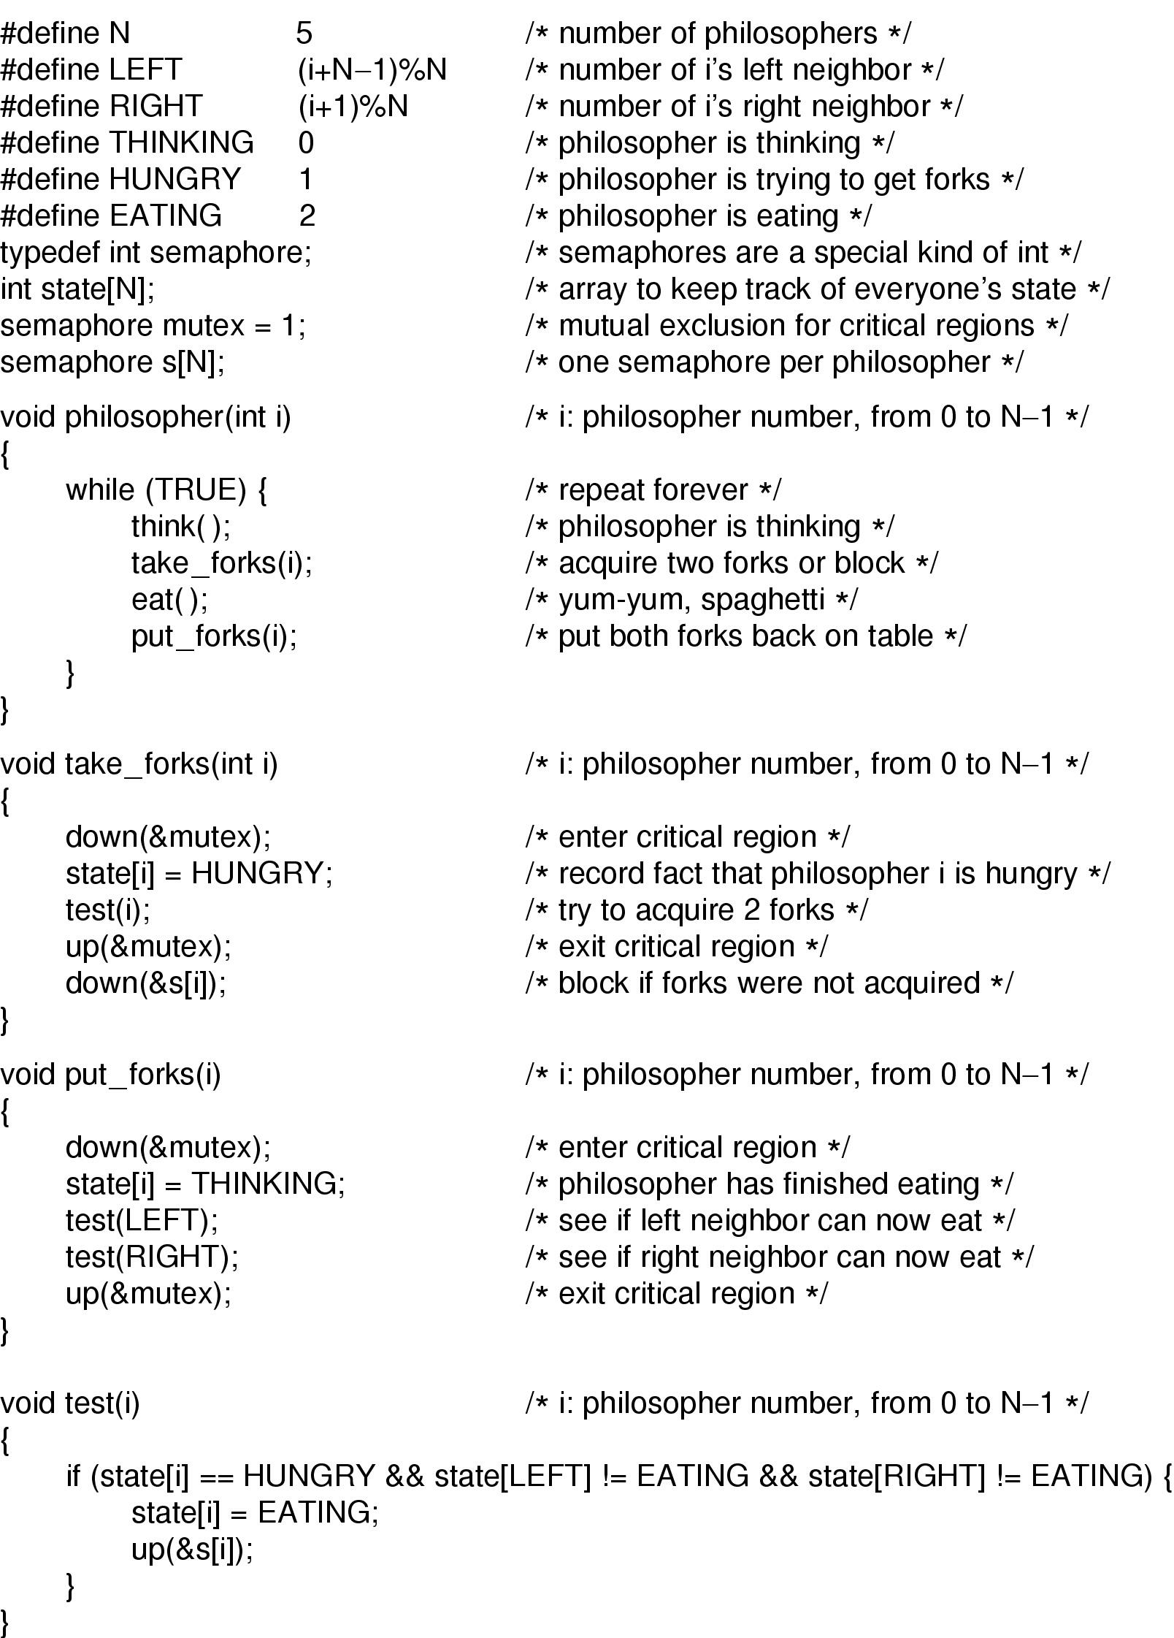
Dining Philosophers Solution

Slide 69
Dining Philosophers Solution

Slide 70
Other Issues
Two-phase locking
Communication deadlocks
Livelock
Starvation

Slide 71
Two-Phase Locking
Phase One
  process tries to lock all records it needs, one at a time
  if needed record found locked, start over
  (no real work done in phase one)
If phase one succeeds, it starts second phase,
  performing updates
  releasing locks
Note similarity to requesting all resources at once
Algorithm works where programmer can arrange program can be stopped, restarted

Slide 72

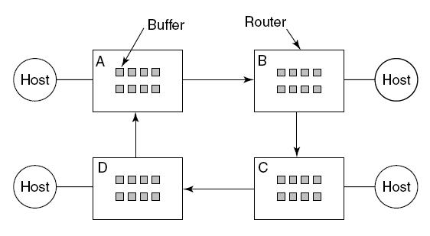

Figure 6-15. A resource deadlock in a network.

Slide 73
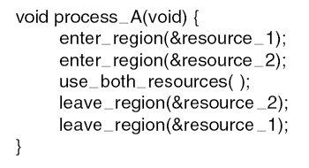
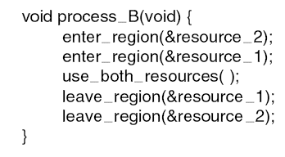
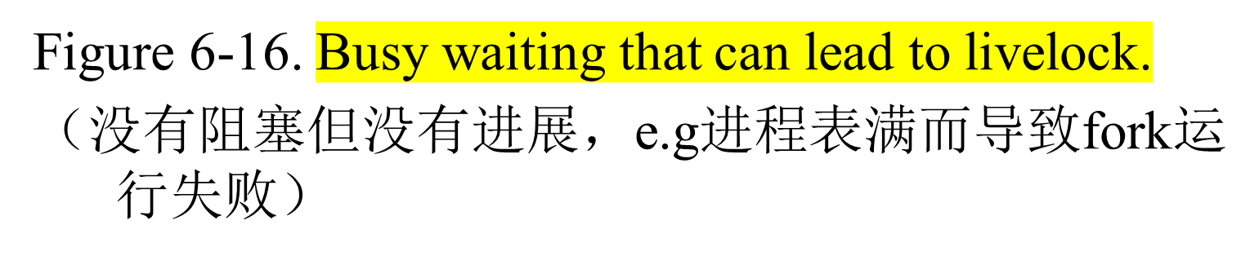
Livelock

Slide 74
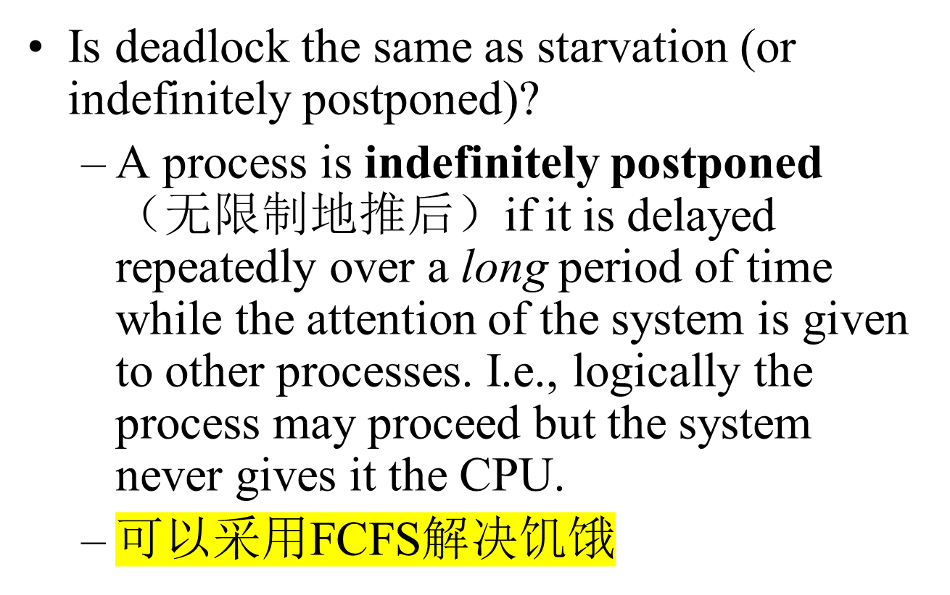
Starvation饥饿

Slide 75
Deadlock Summary
In general, deadlock detection or avoidance is expensive
Must evaluate cost of deadlock against detection or avoidance costs
Deadlock avoidance and recovery may cause indefinite postponement
Unix and Windows use Ostrich Algorithm
Homework:
  P264-P266: 22，23，25，26,28，30

